Slide 1
ActionDirector Mobile Proposal
PM: Elvis Chen

Slide 2
ActionDirector Android
New
Feature set
Basic info
Reverse
Repeat
Support 9:16 video
Video Speed
Trim
Color adjustment
Brightness, Contrast, Saturation
Add title
Modify font, size, color, rotation
Add background music
With volume control, mixing, fade
Produced & share video
Easy to use
One clip one time
No project concept
For phone and tablet
Android 4.3 or above
No 360 video support
ACD VR will be another product (TBD)
From PDR

Slide 3
ActionDirector Android
Versioning
Limitation of Free version
Free version with IAP
Lock Full HD output
With rewarded ad to unlock
Has watermark on video
With rewarded ad to unlock
Add ads after 0.5M downloads
IAP Product
Upgrade to full version
Remove watermark
Remove ads
Unlock FullHD output (HW dependent)

Slide 4
Vertical Layout w/o project (one video in, one video out) Centralized Mode

Slide 5
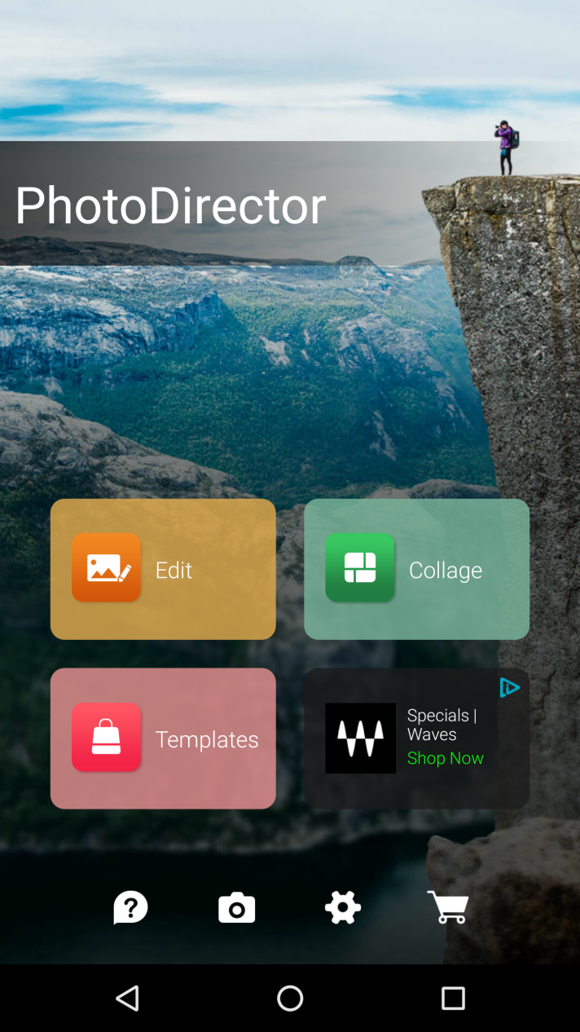

UI Proposal
CyberLink
ActionDirector
Have a splash for a second to load ads and run performance tests

Slide 6

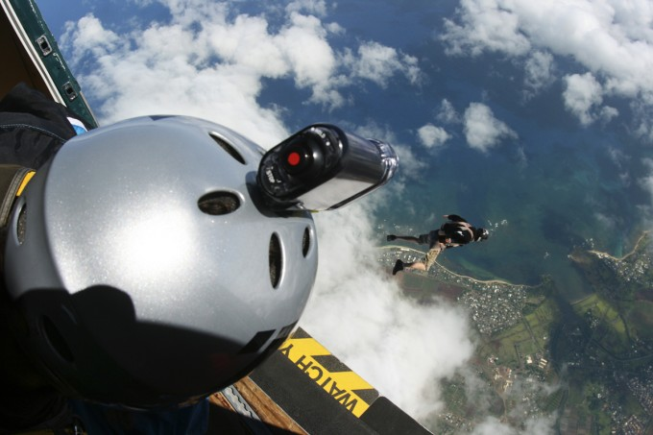

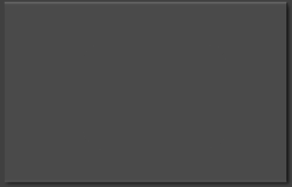


UI Proposal
ActionDirector
Settings
Best Examples for Action Effects!
Rolling contents and ads
Watch Now
Select existed video by our file picker
Intent default camera app
Capture
Edit
?
To tutorial list including reverse/repeat examples
Tutorial
My Video

Slide 7

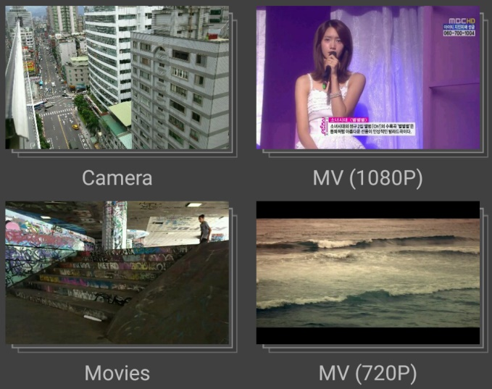

Import video
Import video
Tap to enter folder

Slide 8
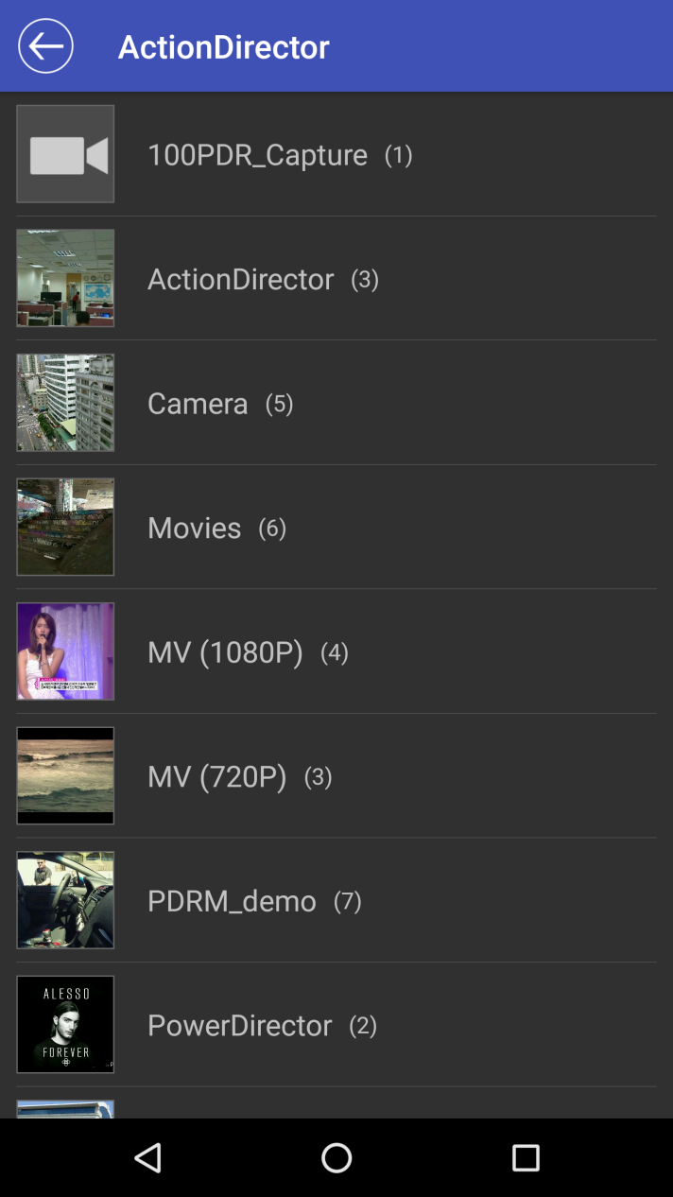
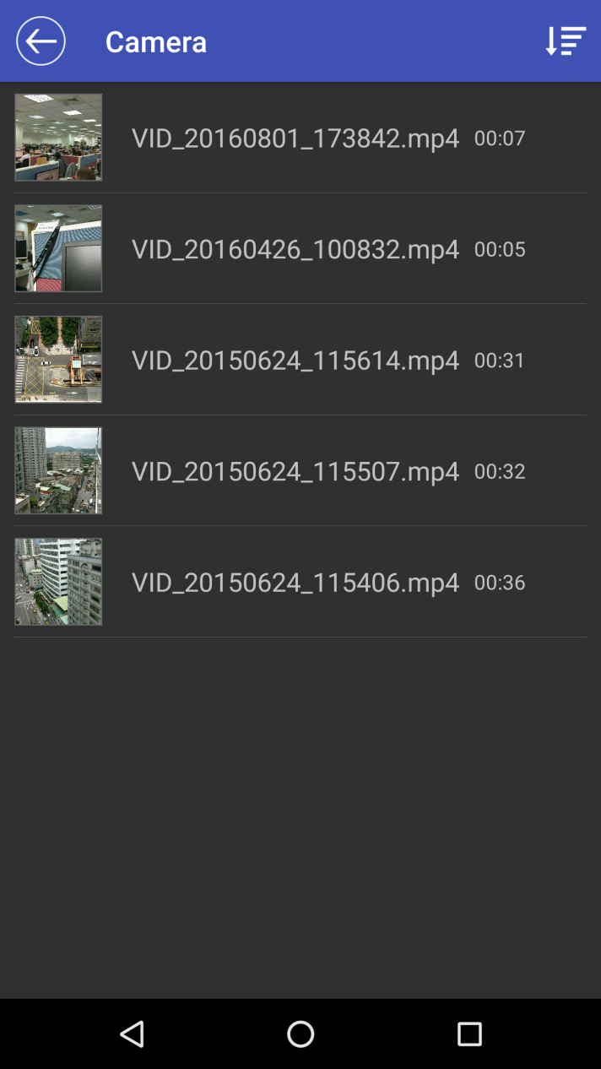
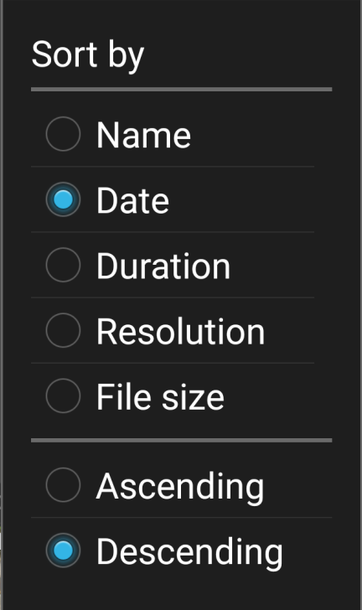
Import video
Scan to show available folders
Sorting options (only in the folder)
Select to preview/import

Slide 9
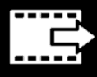
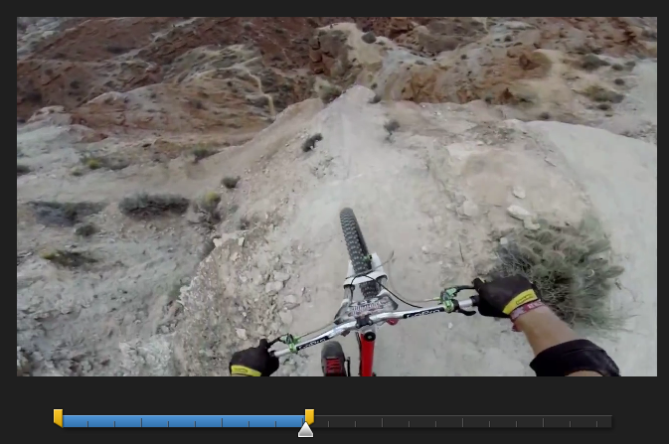

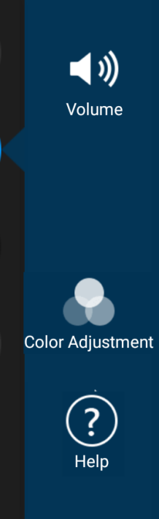
Edit page (16:9 video)
Produce & Share
Edit tools:
Trim
Action Effect (video speed, repeat, reverse)
Color adjustment
Title
Audio
00:00
00:34
T
Trim
Title
Action Effect
Audio

Slide 10
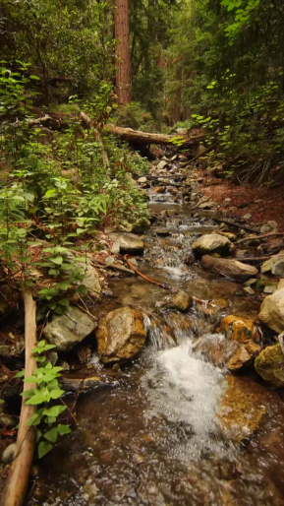
Edit page (9:16 video)
Auto detect the video orientation to set correct project aspect ratio
00:00
00:34
T
Trim
Title
Action Effect
Audio

Slide 11

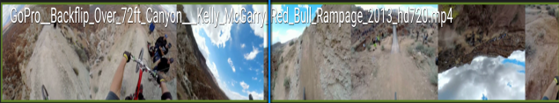
Trim
Trim video
Tap to preview result
Wipe to seek in smaller steps (0.1 sec)
Tap to apply
Duration: 00:34
In: 00:01
Out: 00:35
Drag markers to trim and show current frame
Play head does not move out of marked part
Remove reset

Slide 12
Action Effect: Speed
Action Effect
Single time shift and select whole clip by default
Fit screen
Speed
Repeat Reverse
Select to Speed by default
1x
Last Play
Apply to
Add speed ratio display

Slide 13
Action Effect: Speed
Action Effect
user may drag left/right side to adjust selection
Speed
Repeat Reverse
1x
Last Play
Apply to

Slide 14
Action Effect: Speed
Action Effect
Speed
Repeat Reverse
0.5x
Drag to adjust speed
(1/8~8x)
Last Play
Apply to

Slide 15
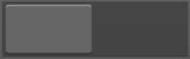
Action Effect: Repeat
Action Effect
Tap to adjust play times
Default is 1 times
Speed
Repeat Reverse
This control will be available if play times are 2 times or more
Play time(s) : 1
With Reverse

Slide 16
Action Effect: Repeat
Action Effect
Play time(s)
1
2
3
4
5
Cancel
Select to apply & close dialog
Speed
Repeat Reverse
Play time(s) : 1
With reverse

Slide 17
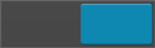
Action Effect: Repeat
Action Effect
Apply reverse effect to the repeat parts except the last play
Speed
Repeat Reverse
Control name proposals:
With reverse
Add reverse
Reverse when repeating
Continuous Repeat
Play time(s) : 2
With reverse

Slide 18
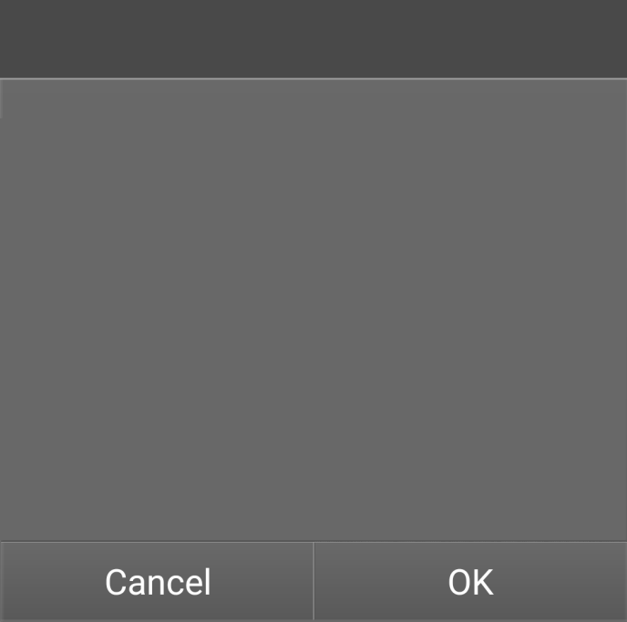
Action Effect: Reverse
Action Effect
Effect Conflict
Reverse cannot co-exist with repeat, do you like to disable repeat?
Repeat cannot co-exist with reverse, pops up a msg when switching to Reverse tab
Tap Cancel to back to Repeat tab, tap OK to set play time to 1 and go to Reverse tab
Speed
Repeat Reverse
Reverse effect

Slide 19
Action Effect: Reverse
Action Effect
Speed
Repeat Reverse
Switch for Reverse effect, default is off
Reverse effect

Slide 20
Action Effect: Reverse
Action Effect
Start rendering if preview or tap OK
Tap to decide which play time to reverse
Speed
Repeat Reverse
Reverse effect

Slide 21
Action Effect: Repeat
Action Effect
Effect Conflict
Repeat cannot co-exist with reverse, do you like to disable reverse?
Repeat cannot co-exist with reverse, pops up a msg when switching to Reverse tab
Tap Cancel to back to Reverse tab, tap OK to disable reverse and go to Repeat tab
Speed
Repeat Reverse
Play time(s) : 2
With reverse

Slide 22
Color Adjustment
Color Adjustment
OK to apply settings and back to Edit
00:34
00:00
Display current parameter
Parameter range
Brightness: -100~100
Contrast: -100~100
Saturation: 0~200
Brightness
0
Contrast
0
Saturation
100

Slide 23
UI Proposal: Title
Title
Tap to add a title from 4 types:
1. Intro
2. Default
3. Outtro
4. Credits
00:00
00:34
Select a title template:
CyberLink
CyberLink
STAFF
CyberLink
+
CyberLink
Director
Producer
Intro
Default
Outtro
Credits

Slide 24


UI Proposal: Title
Tap to remove selected title
Title
Tap to Title Designer
X
CyberLink
Tap to edit text
Update duration
00:05
00:39
T
Default duration is 5 sec.
User can drag the left/right side to change duration, CPI will move together and show time code
Select a title template:
CyberLink
CyberLink
STAFF
CyberLink
Director
Producer
Intro
Default
Outtro
Credits

Slide 25
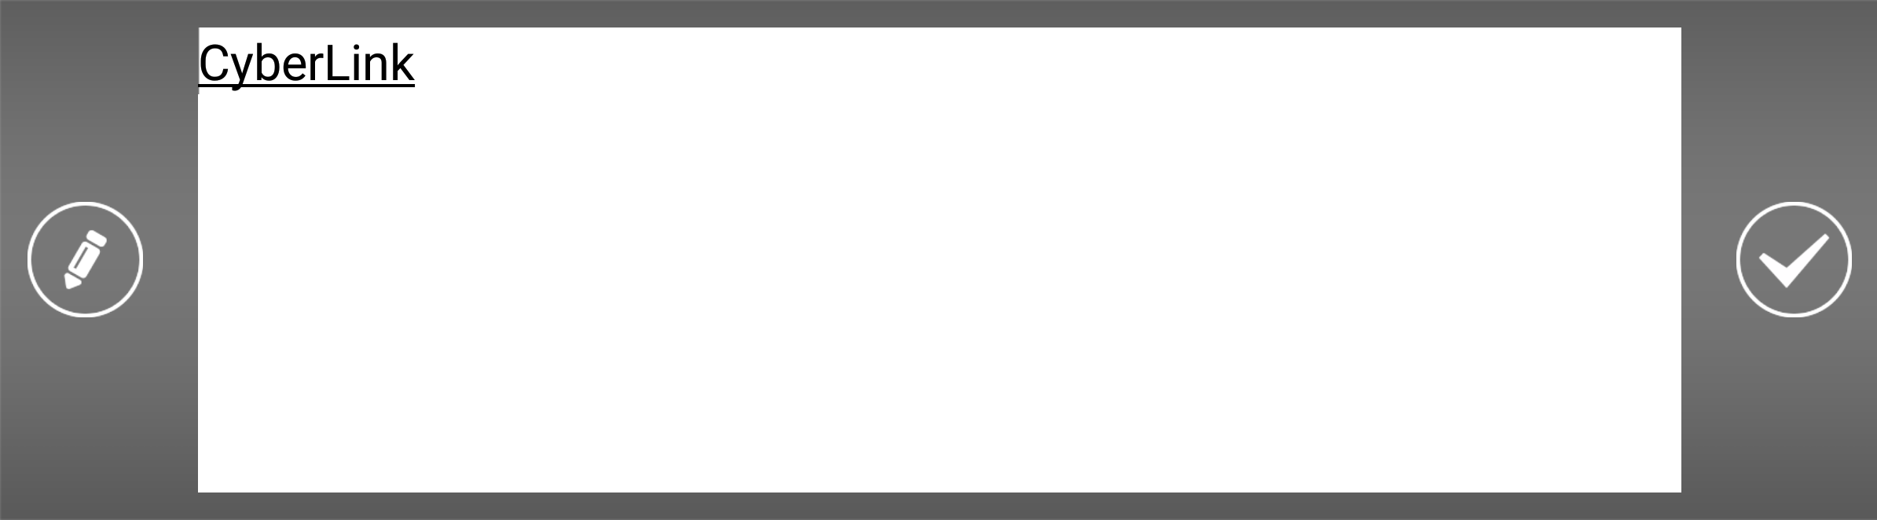

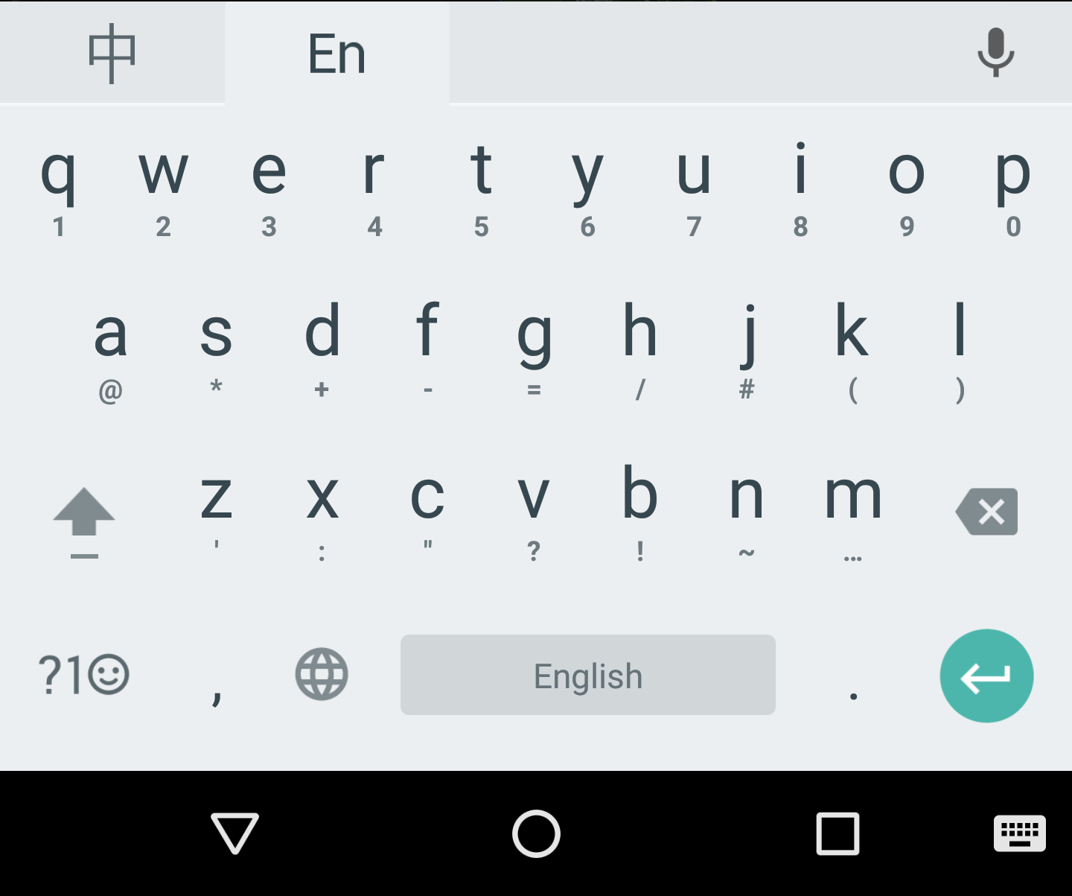
UI Proposal: Title
Title
Title Designer
(Should be able to change background color)
00:00
00:34
OK to apply texts
Tap to adjust duration Default is 5 sec
Select a title template:
+
Watermark
Outtro
Intro

Slide 26
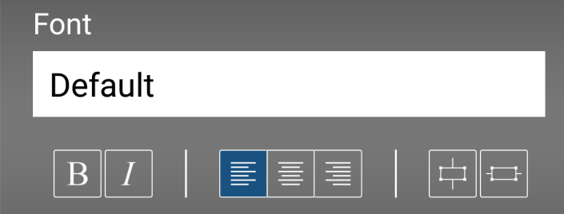
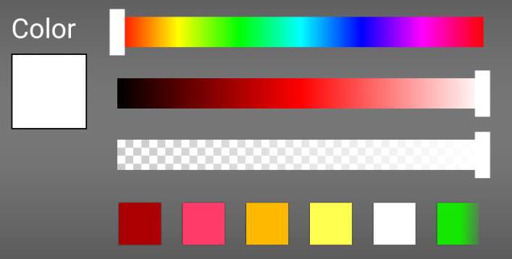
UI Proposal: Title
Title
CyberLink
00:00
00:34
Title Designer controls are the same as PDR
Select a title template:
+
Watermark
Outtro
Intro

Slide 27
UI Proposal: Title
Title
X
CyberLink
00:05
00:39
T
T
User can add multiple titles
Select a title template:
CyberLink
CyberLink
STAFF
+
CyberLink
Director
Producer
Intro
Default
Outtro
Credits

Slide 28


UI Proposal: Audio
Audio
OK to apply settings and back to Edit
Original audio
Default is On
Background music
Song name.
Default is Off, enable to browse music by our file picker
Audio Mixing
100
From 0~200%, default is 100%
200
Fade in
Fade out
Default is Off

Slide 29
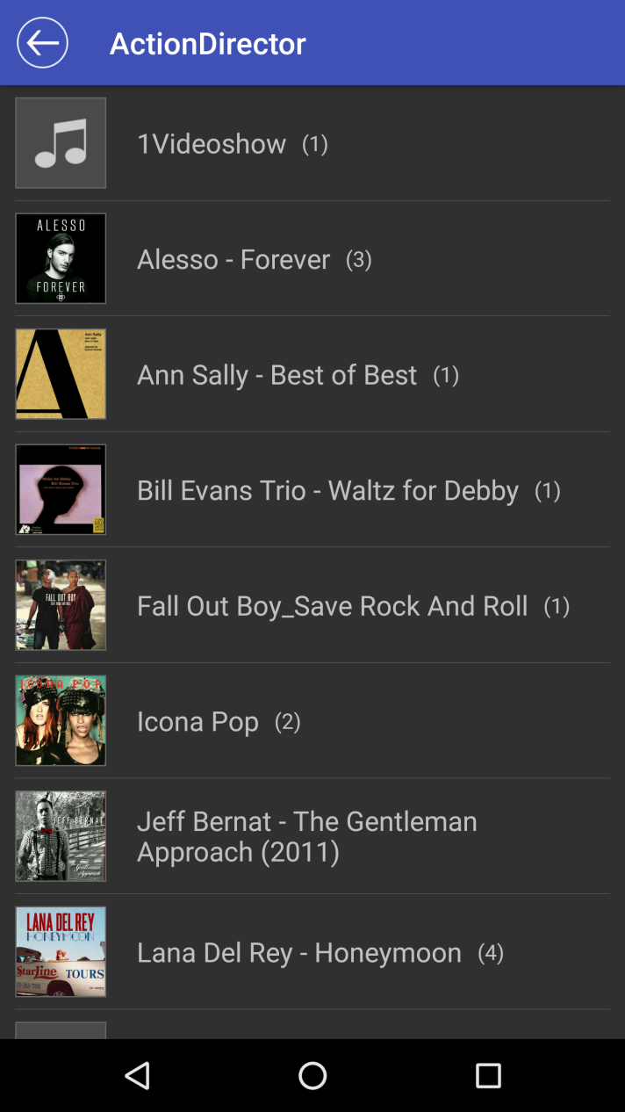
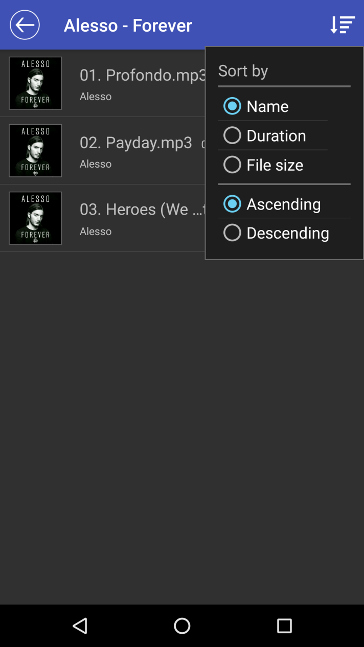
Import video
Tap to enter folder
Sorting options (only in the folder)
Background Music

Slide 30

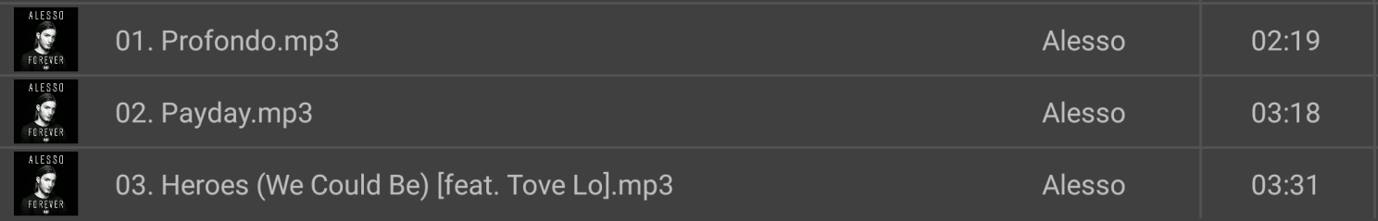
Import video
Alesso - Forever
02. Payday.mp3
03:00
Update trimmed duration
Duration: 03:00
Add
Select to preview, trim and add
In: 00:18
Out: 03:18

Slide 31
Produce
Tap to produce page
Produce
00:00
00:34
T
Trim
Title
Action Effect
Audio

Slide 32
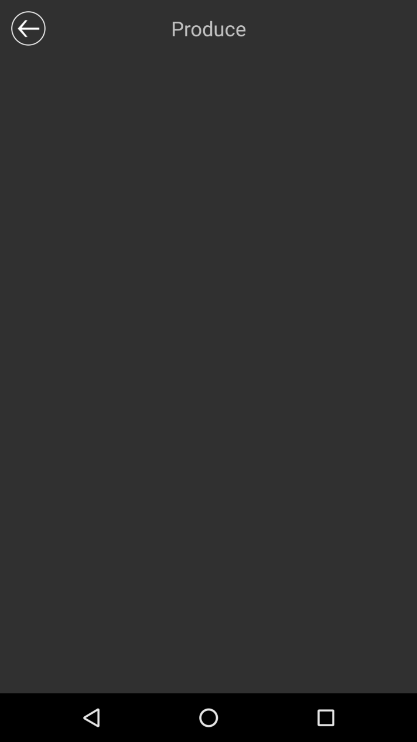



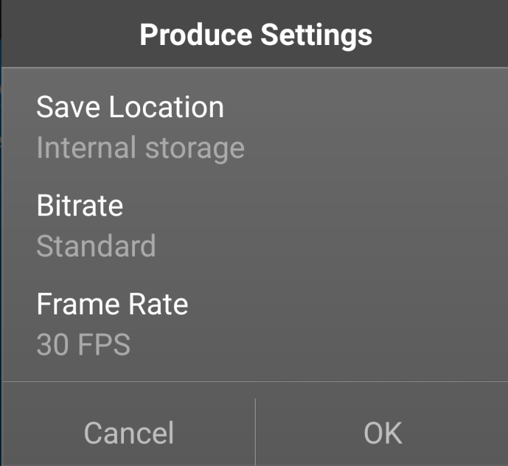
Produce
Select video resolution:
Produce settings
HD
SD
Start
Settings
You may also share to YouTube, Facebook or other apps after producing.
Potential place for ad

Slide 33
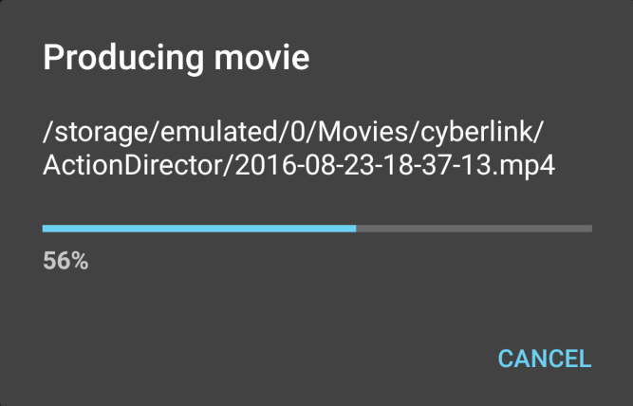
Produce
Select video resolution:
Producing a file first
HD
SD
to your device:
Start
Settings
You may also share to YouTube, Facebook or other apps after producing.

Slide 34
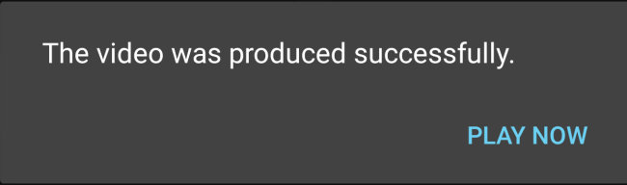
Produce
Display after producing:
Tap OK to back to launcher
Tap Share to… to intent menu
Tap Play Now to play in full screen, then tap back to My Videos
Select video resolution:
HD
SD
Start
Settings
You may also share to YouTube, Facebook or other apps after producing.
OK SHARE

Slide 35

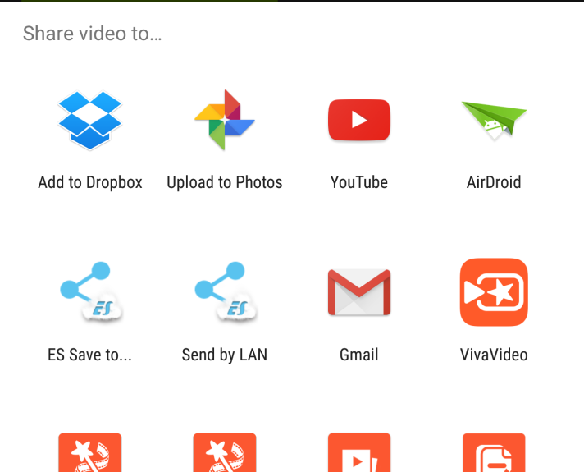
Produce
Select video resolution:
HD
SD
Start
Settings
Display intent menu
You may also share to YouTube, Facebook or other apps after producing.

Slide 36
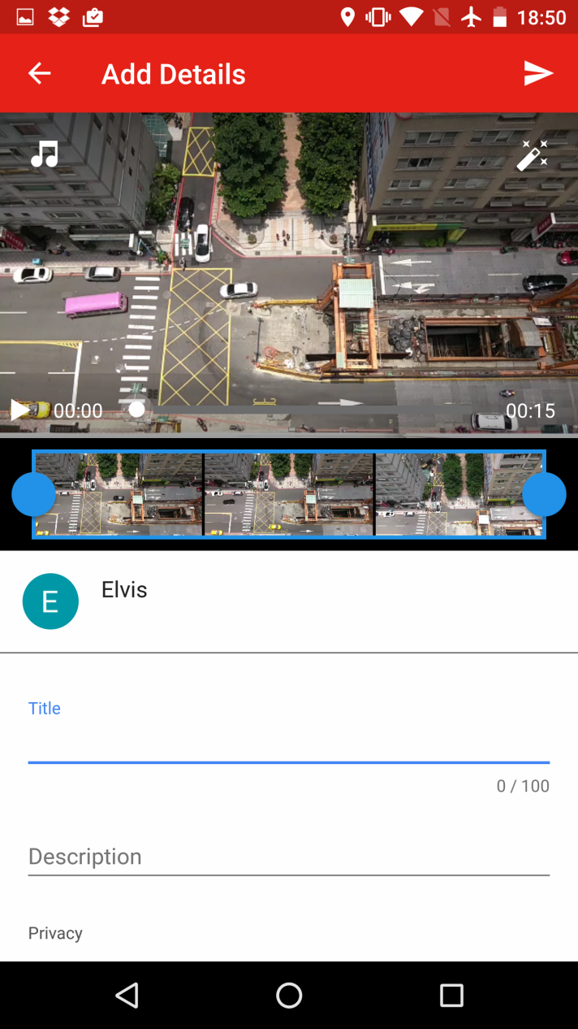
Produce
Intent selected apps to share

Slide 37
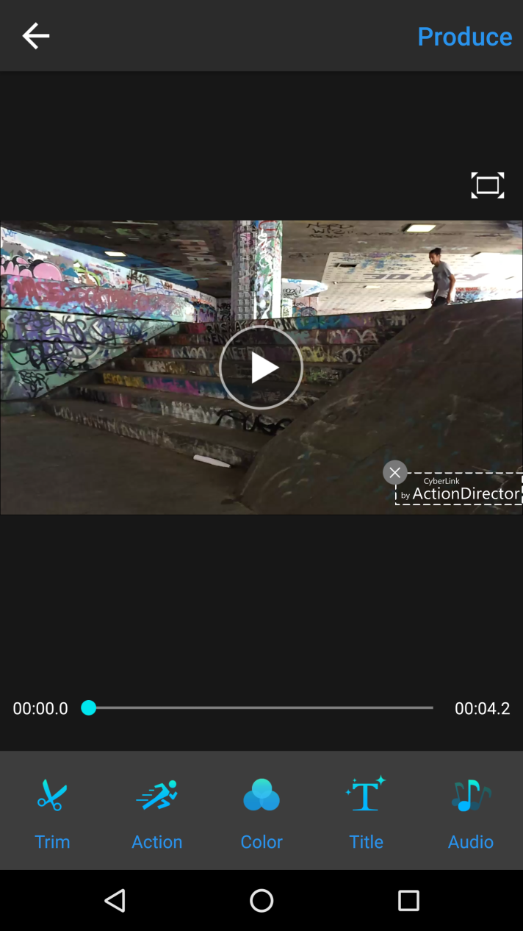
Rewarded ads
Trigger IAP
(Needs to preload ad)

Slide 38
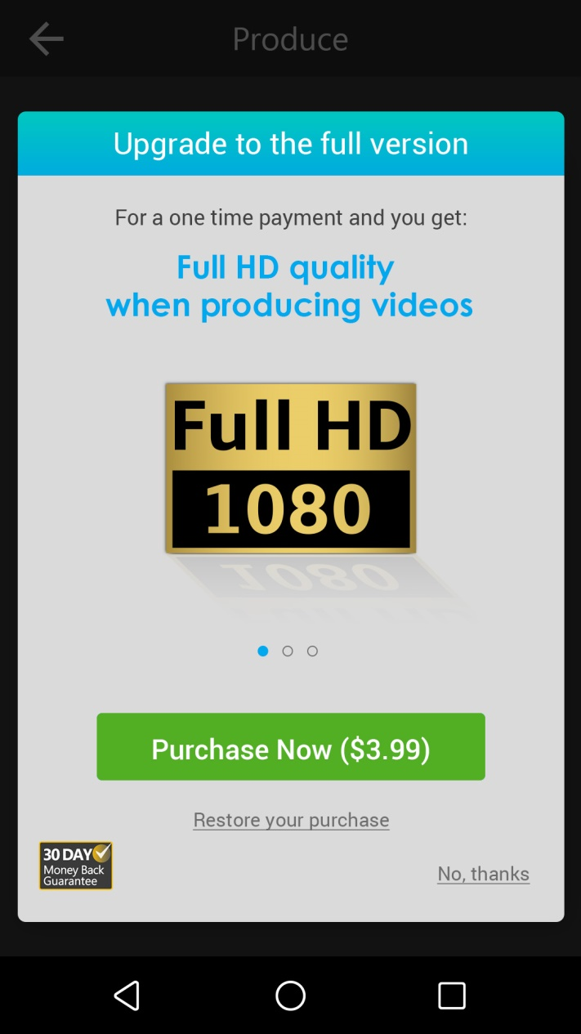
Rewarded ads
Make sure rewarded ad is available when user tap “No, thanks” or back

Slide 39
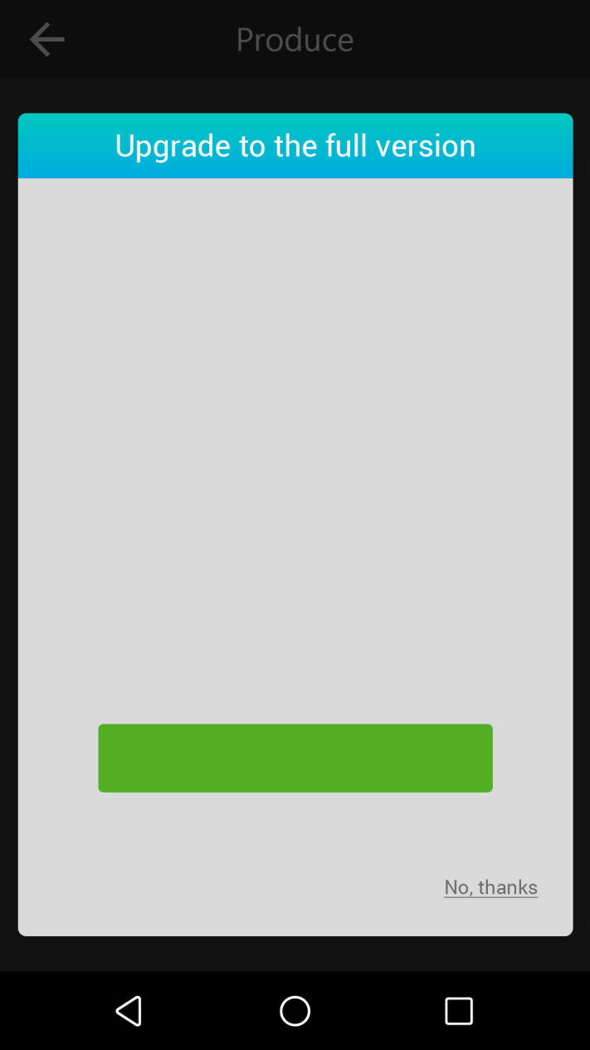

Rewarded ads
Still interested in the features? Watch the ad below to unlock it for a limited time so you can use it on your current project.
Tap to play ad and unlock limitations in 10 min (the duration should be able to control)
Tap to back to IAP dialog
Watch ad to unlock
Back to UI
Purchase to unlock forever
Back to UI

Slide 40
V1.01 Features
Refine reminder before updating Action Effect
Fix Nexus 5X color space conversion issue
Other bug fixes

Slide 41
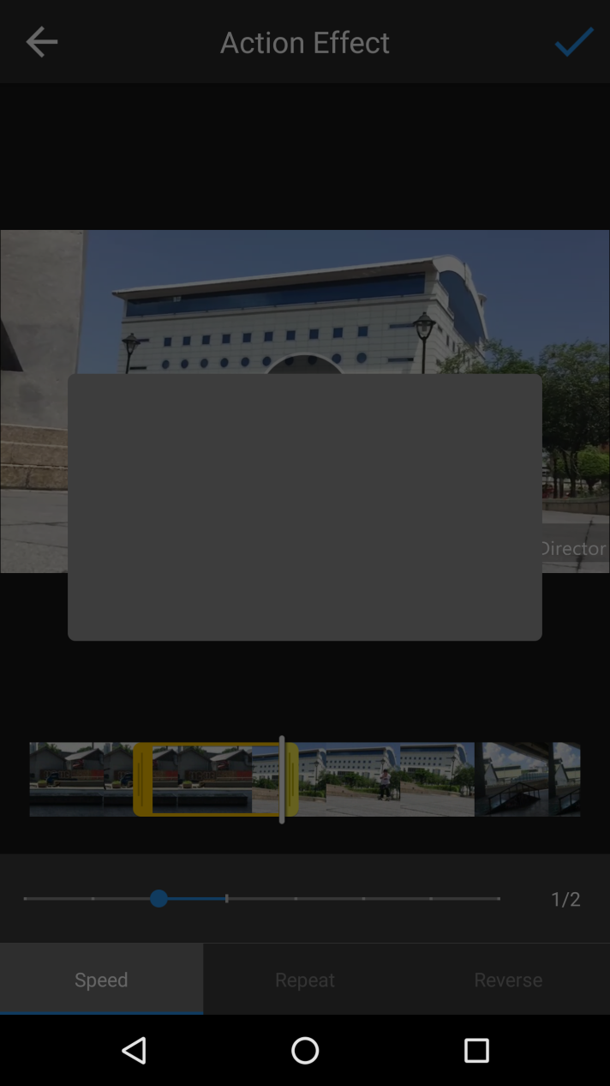
Reminder before updating Action Effect
The edits you made will be
applied to the current time shift
Default is checked
V
Show this tip next time
OK

Slide 42
Appendix

Slide 43
Feature for Later Version
Multiple time shift
Speed: Ease in/out
Trim: Mark in/out button (TBD)
Multiple titles

Slide 44
UI Proposal: Action Effect
Action Effect
Tap to create another time shift at CPI position
(pops up a message to teach user if current place is not available)
Tap to delete selected time shift
(pops up a message to teach user if current place is not available)
[+] Create time shift
0.5x
Speed
Replay Reverse
Ease in/out:

